Slide 1


Replication
Updates on MariaDB 10.2/10.3
Lixun Peng, MariaDB Foundation
Shenzhen, 2017.11.14

Slide 2
Flashback
Done (10.2):
MDEV-10570: Integrate existing DML only "Flashback”for MariaDB Server 10.2
MDEV-12019: FLASHBACK: Server crashes in bitmap_bits_set / pack_row / THD::binlog_write_row
MDEV-12066: mysqlbinlog --flashback does not reverse replace statements
MDEV-12067: flashback does not correcly revert update/replace statements
MDEV-12337: Flashback and foreign key
On the way (10.3):
MDEV-10570: Implement support to handle DDL Statements with Flashback
Support GTID Filter (Flashback to GTID)
Support Event Filter (Flashback special type of Events)

Slide 3
SemiSync
MDEV-13073: AliSQL: [Performance] Issue #40 Optimize performance of semisync
Make semisync buidin to completely remove overhead of plugin lock.
Remove LOCK_log requirement from dump thread
Now user threads can wait for ACK before innodb commit. add rpl_semi_sync_master_wait_point to control this behavior(AFTER_COMMIT/AFTER_SYNC)
Add a new ACK thread to handle ACK from slave.
The IO thread flushs master info only when ACK is needed add rpl_semi_sync_slave_delay_master to control this behavior
Fix bug#70669, if sync_binlog = 1 ,then notify dump thread after fsync of binlog file.
Branch: bb-10.2-semisync

Slide 4
gtid_pos_auto_engines
This variable is used to enable multiple versions of the mysql.gtid_slave_pos table, one for each transactional storage engine in use. This can improve replication performance if a server is using multiple different storage engines in different transactions.
The value is a list of engine names, separated by commas (','). Replication of transactions using these engines will automatically create new versions of the mysql.gtid_slave_pos table in the same engine and use that for future transactions (table creation takes place in a background thread).
This avoids introducing a cross-engine transaction to update the GTID position. Only transactional storage engines are supported for gtid_pos_auto_engines (this currently means InnoDB, TokuDB, or MyRocks).

Slide 5
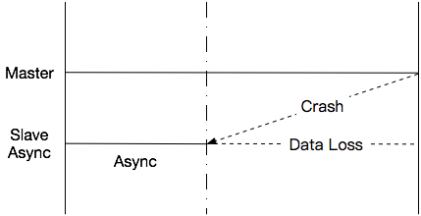
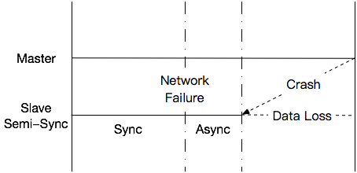
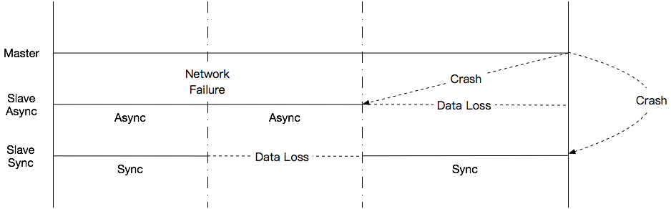
Double Sync (Hope to Open Source)
Async
SemiSync
DoubleSync

Slide 6

